Slide 1
Why Atoms Form Molecules
…and How
Jason R Mayberry, PhD

Slide 2
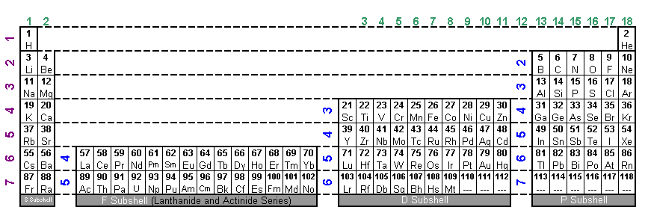
Why Form Molecules?
Atom’s Requirements to be Stable:
  Be Neutral: Have the same number of Electrons as it does Protons.
  (As we’ve presented them….all start out with this desire met.)
  Octet Rule: Once a row on the Periodic table is started, finish the row or empty it.
  ∴ Atoms will seek to have 8 or 0 valence electrons (2 or 0 for H and He)
Only group 18 (Noble Gasses) satisfies both; the rules conflict for all other atoms.
When alone atoms must “choose” which to satisfy.
Satisfy Octet Rule If…
Only need to gain or lose 1 or 2 electrons to get there
Remain Neutral If…
Need to gain or lose more than 2 electrons to satisfy the octet rule.
11
12
13
14
15
21
22
23
24
25
31
32
33
34
35
41
42
43
44
45
51
52
53
54
55
16
17
18
19
20
26
27
28
29
30
36
37
38
39
40
46
47
48
49
50
56
57
58
59
60
10
1
2
3
4
5
6
7
8
9
61
62
63
64
65
71
72
73
74
75
81
82
83
84
85
91
92
93
94
95
101
102
103
104
105
111
112
113
114
115
66
67
68
69
70
76
77
78
79
80
86
87
88
89
90
96
97
98
99
100
106
107
108
109
110
116
117
118
2
3
4
5
7
1
6

Slide 3
Ionic Bonds
Resolving the conflict between the desire to be neutral and have an octet in the valence shell.

Slide 4
Ionic Bonds--- TRANSFERRING ELECTRON
To fulfill the Octet Rule, Sodium needs to give up an electron and Chlorine needs to gain an electron.
When forming ions Sodium will give its one valence electron to Chlorine.
100% of the electron’s energy will be transferred to Chlorine
This results in each ion having an opposite charge.
The opposite charges cause the two ions to be attracted to each other so they form a bond.
The balance of their opposite and equal charges makes both Sodium and Chlorine “happy” because “together” they are neutral and have an octet.
Because no ENERGY is shared between the atoms, these bonds are weaker than covalent.
11
17
Sodium with no Charge
Chlorine with no Charge
11
17
Sodium cation with a charge of +1
Chlorine anion with a charge of -1
11
17
Ionic Bond
NaCl, Sodium Chloride (Table Salt)

Slide 5
Lewis Dot Structure for ionic compounds
Lewis Dot Structure for ionic compounds
Write the atomic symbols for the ions side-by-side
Draw the electrons around each ion as they are after the exchange of electrons
Sometimes brackets are used to make it clear to which ion the electrons belong
Use superscripts to show the charge around each ion
Individual Atoms
Ionic Bond
+1
-1
Na
Cl
Na
Cl
Sodium and Chlorine atoms
Sodium Chloride

Slide 6
Possibilities for Ionic Bonds
Any combination of ions can come together to form ions (as long as the net charge is zero)
+1
-1
Na
Cl
Na
Cl
Sodium and Chlorine atoms
Sodium Chloride molecule
What could replace Na? What could Replace Cl?
+1
-1
K
Na
K
Cl
Na
Cl
+1
-1
Na
F
Na
F
+1
-1
K
F
K
F

Slide 7
What could Form an Ionic Bond with Magnesium
+2
-2
Mg
O
Mg
O
+2
-2
Mg
S
Mg
S
What could replace Magnesium
+2
-2
Be
O
Be
O
+2
-2
Ca
S
Ca
S

Slide 8
You can have more than two atoms in an ionic bond
How can you make an Ionic bond between group 2 and group 17 atoms?
Mg
-1
+2
-1
F
Mg
F
F
F
How can you make an Ionic bond between group 1 and group 16 atoms?
Li
+1
-2
+1
O
Li
O
Li
Li

Slide 9
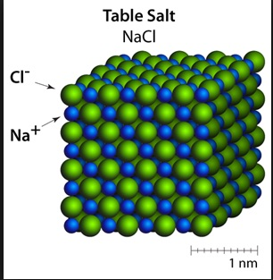
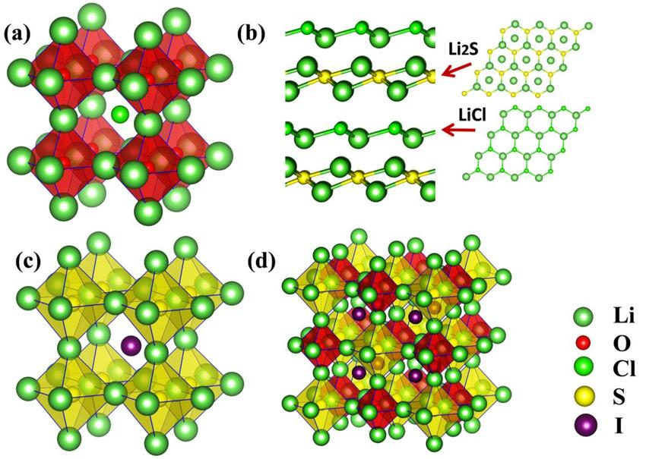
Molecules vs Compounds
Ions don’t actually form discrete molecules…
…Instead they form compounds comprised of crystal latices where many ions are inter-connected by ionic bonds.

Slide 10
Covalent Bonds
Resolving the conflict between the desire to be neutral and have an octet in the valence shell.

Slide 11
Covalent Bonds
Atom’s Requirements to be Stable:
  Be Neutral: Have the same number of Electrons as it does Protons.
  (As we’ve presented them….all start out with this desire met.)
  Octet Rule: Once a row on the Periodic table is started, finish the row or empty it.
  ∴ Atoms will seek to have 8 or 0 valence electrons (2 or 0 for H and He)
Atoms like Carbon don’t form ions…how can they satisfy both requirements?
Covalent Bonds
Atoms move close so their valence shells overlap
Electrons in overlapping valence shells are shared and count toward the octet of both atoms.
Because electrons are not given/taken, neither atoms take on any charge
Because the atoms share the electrons in common, covalent bonds are stronger than ionic.
A pair of shared electrons is represented with a dash
Lewis Dot Structure for Covalent Bonds
H
H
H
H
C
H
H
H
C
H
C
H
H
H
H
Chemical Formula
CH₄

Slide 12
Required Number of Covalent Bonds
Atoms will always form the number of covalent bonds needed to get to 8 valence electrons (or 2 for H)
If they don’t have enough valence electrons to get to 8 by sharing, they won’t form covalent bonds.
Lithium
Berylium
Carbon
Nitrogen
Oxygen
Fluorine
Li
Be
C
N
O
F
Has 1 e-
Needs 7 e-
Wont form Covalent Bonds
Has 2 e-
Needs 6 e-
Wont form Covalent Bonds
Has 4 e-
Needs 4 e-
Forms 4 Covalent Bonds
Has 5 e-
Needs 3 e-
Forms 3 Covalent Bonds
Has 6 e-
Needs 2 e-
Forms 2 Covalent Bonds
Has 7 e-
Needs 1 e-
Forms 1 Covalent Bonds
H
H
n.a.
n.a.
H
C
H
N
H
O
H
F
H
H
H
H

Slide 13
Lithium
Berylium
Carbon
Nitrogen
Oxygen
Fluorine
Li
Be
C
N
O
F
Number of Valence Electrons
Number electrons needed
Number of Covalent Bonds it will form

Slide 14
Covalent Bonds
Atoms can form single, double and triple bonds.
H
Single Bond:
One pair of shared electrons
Represented by a single dash
H
H
H
C
H
H
C
H
H
C
H
H
H
H
Double Bond:
Two pairs of shared electrons
Represented by two dashes
O
C
O
O
C
O
O
C
O
Triple Bond:
Three pairs of shared electrons
Represented by three dashes
H
C
N
H
C
N
H
C
N
Quadruple Bonds:
not possible

Slide 15
Lewis Dot Structures for Covalent Bonds
Lewis Dot Structure for Covalent Molecules
Write the atomic symbols for the atoms side-by-side
Write a dash between and connecting the two atoms to represent each PAIR of shared electrons.
Use dots around each atom to represent the remaining pairs of electrons
Note 1: You can compare each atom in the molecule to the Lewis Dot Structure for the individual atom to make sure all pairs of electrons in the Lewis dot structure are also in the molecule, single electrons should be represented by a dash because they will be shared with neighboring atoms.
Note 2: Sometimes the pairs electrons are not drawn and are assumed to be there.
Methane
(CH₄)
Carbon Dioxide
(CO₂)
Amonia
(NH₃)
H
H
H
C
H
O
C
O
N
H
H
H

Slide 16
Make-Up-Your-Own-Molecule
Make any molecule you can imagine…
… with any combination of single double and triple bonds,
..and any number of atoms
… as long as every atom has the right number of bonds.
Draw a molecule with the following formula:
C₄N₂O₂H?
Where H? means the number of H can vary as needed
Draw other molecules with the same atoms arranged differently.
H
O
O
H
H
C
C
C
C
N
H
C
H
H
N
H
O
H
O
C
N
C
N
C
H
O
O
H
H
C
C
H
C
C
H
H
O
O
N
N
H
H
N
C
C
C
C
N
What other atoms form 4 bonds and could replace C? What could replace N? O? H?
How big could you make a molecule? What patterns could you produce?

Slide 17
Summary Questions
Which atoms only form Ionic Bonds?
Which atoms only form Covalent Bonds?
Which atoms can form both Ionic and Covalent Bonds?
What pairs of atoms cannot bond together?
Which atoms won’t form any bonds?
The number of valence electrons determines the number and type of molecular bonds an atom will form.
If has 1 or 2 valence electrons can only lose electrons and form ionic bonds
  Hydrogen (H) is an exception and can also form both ionic and covalent bonds.
If 3-5 valence electrons, can only gain valence electrons by sharing.
If 6-7 valence electrons
  Can accept valence electrons and form ionic bonds
  Can share electrons and form covalent bonds.
If has 8 valence electrons (2 for He) won’t form any bonds.
Groups 1 and 2 will not bond with groups 14 and 15 (H being the exception).

Slide 18
Chemical Formulas
Chemical Formulas
Shorthand for representing Molecules
Use only the atomic symbols
Subscripts indicate how many of the preceding atom are in the molecule
You have to determine what type of bond is formed between the atoms.
Sometimes different atoms will have the same formula (i.e. the atoms are arranged differently)
NaCl
Draw the Lewis Dot structure for each of these molecules.
HCN
MgI₂
CO₂
C₆H₁₂O₆

Slide 19
Summary of Ionic and Covalent Molecular Bonds
General Rules for forming Ions and Ionic Bonds.
In forming ionic bonds, atoms either gain or lose electrons entirely, becoming charged.
If has 1 or 2 valence electrons…MUST lose electrons to become anions (H is an exception)
If has 6 or 7 valence electrons…CAN gain electrons to become cations (BUT may also form covalent bonds)
If has 3-5 valence electrons CANNOT form ions/ionic bonds
An ion will form an ionic bond with one or more ions that together have the opposite charge – the final compound will be electrically neutral.
General Rules for forming Covalent Bonds
In covalent bonds, electrons are not gained or lost but shared; When an atom shares an electron with another atom, the other atom does likewise, so that both effectively gain 1 electron without acquiring any charge.
Figure out how many more valence electrons an atom needs to fill its outermost shell…that is how many bonds it will form.
Atoms form single, double, and triple bonds as needed.
If has 1 or 2 valence electrons…it cannot form covalent bonds because it doesn’t have enough electrons to share to get to 8 valence electrons (H is an exception)
If has 6 or 7 valence electrons…CAN share 2 or 1 electrons (respectively) to gain enough electrons to get to 8 (but may also form ionic bonds)
If has 4-5 valence electrons electrons…MUST share 4 or 3 electrons (respectively) to gain enough electrons to get to 8.
If has 3 valence electrons…weird things happen, but will usually form 3-5 covalent bonds

